Slide 1
Exact Learning
Benedict Irwin, ben@optibrium.com

Slide 2
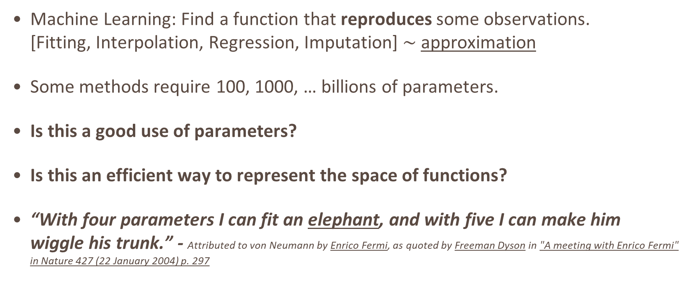
Exact Learning
Machine Learning: Find a function that reproduces some observations. [Fitting, Interpolation, Regression, Imputation] $\sim$ approximation
Some methods require 100, 1000, … billions of parameters.
Is this a good use of parameters?
Is this an efficient way to represent the space of functions?
“With four parameters I can fit an elephant, and with five I can make him wiggle his trunk.” - Attributed to von Neumann by Enrico Fermi, as quoted by Freeman Dyson in "A meeting with Enrico Fermi" in Nature 427 (22 January 2004) p. 297

Slide 3
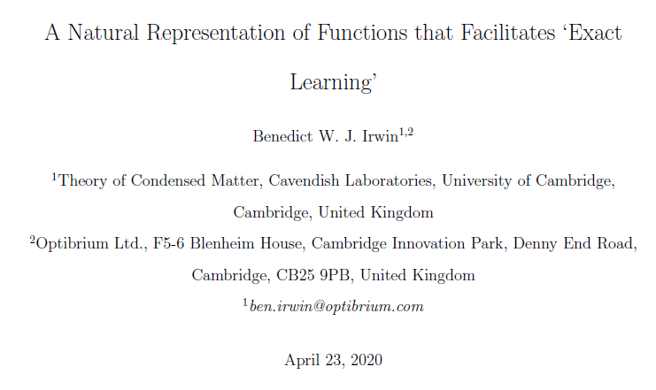
Bank Holiday Weekend : Finally Submitted

Slide 4
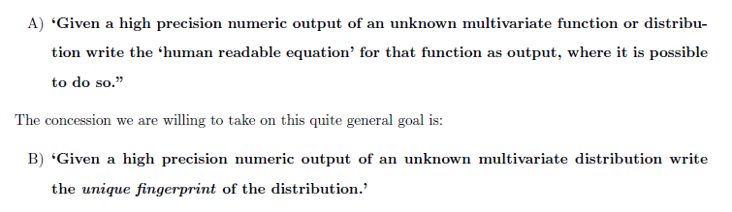
Exact Learning

Slide 5
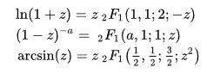
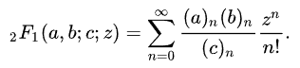
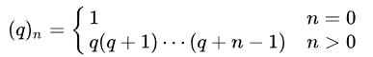
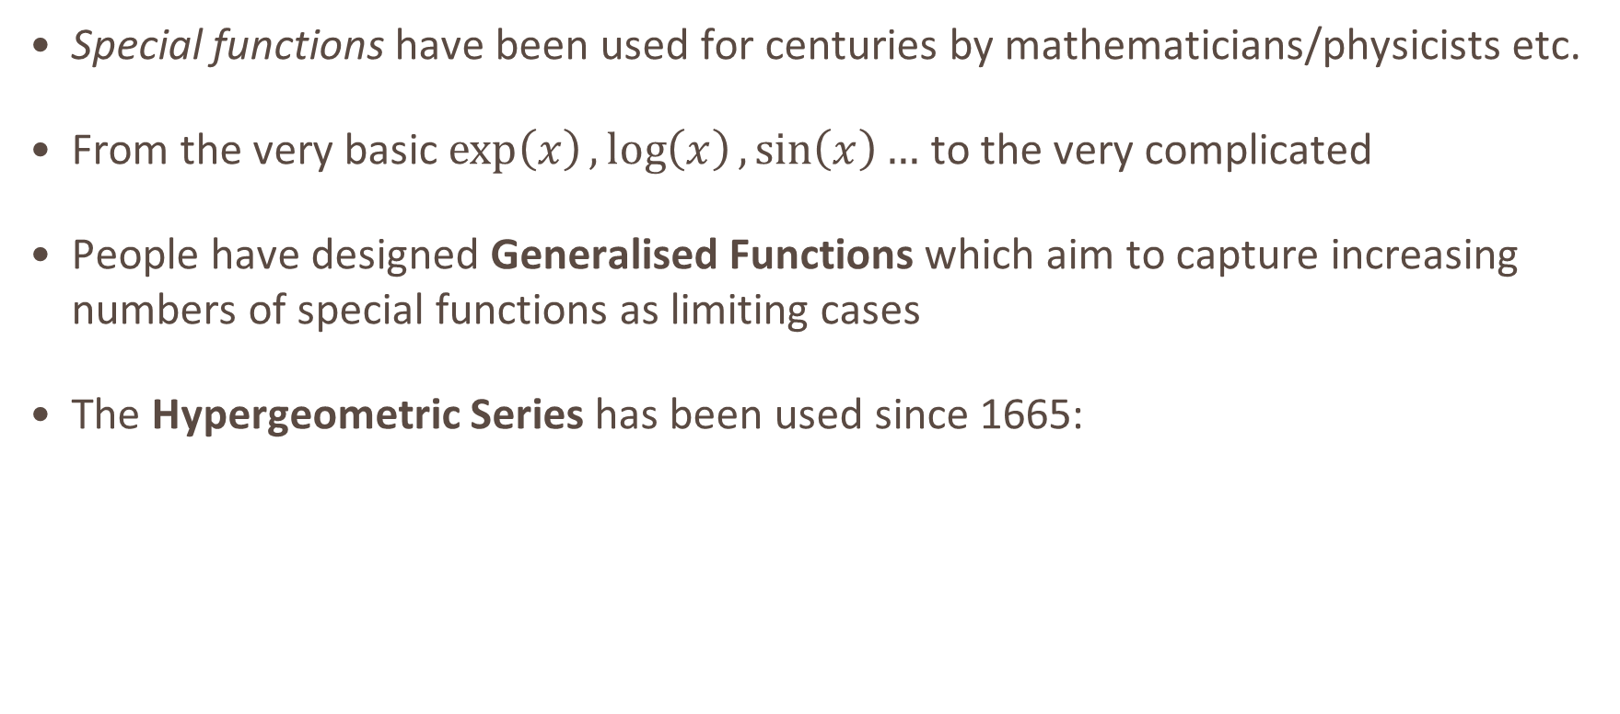
Highly Generalised Functions: Some History
Special functions have been used for centuries by mathematicians/physicists etc.
From the very basic $\exp\left(x\right),\log\left(x\right),\sin\left(x\right)…$ to the very complicated
People have designed Generalised Functions which aim to capture increasing numbers of special functions as limiting cases
The Hypergeometric Series has been used since 1665:

Slide 6
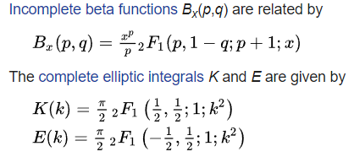
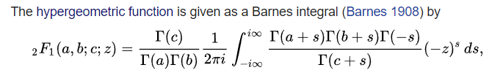
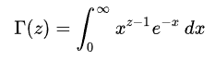
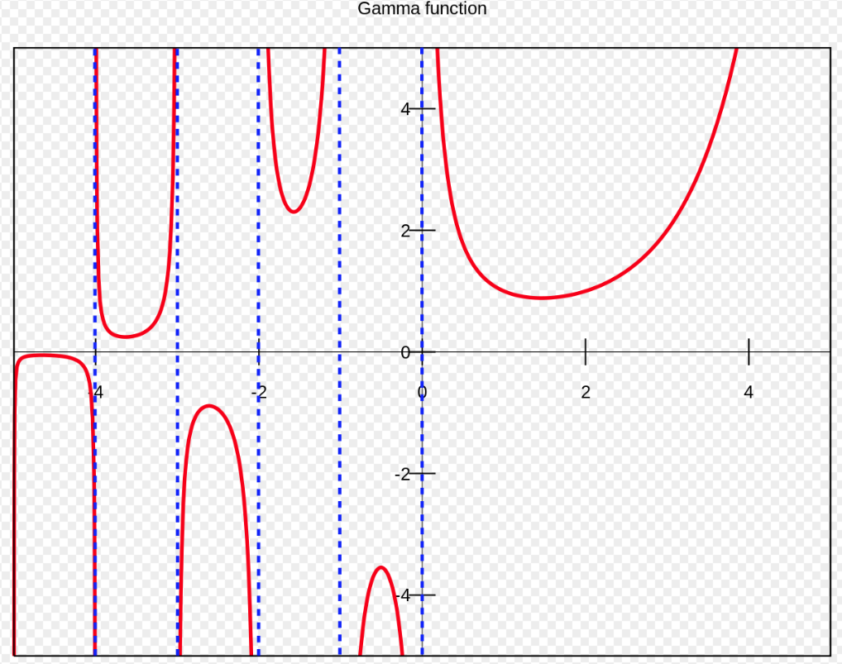
Hypergeometric Series
The series can be written as a contour integral (Barnes)
Notice the Euler Gamma function appears often
Poles in the negative axis

Slide 7
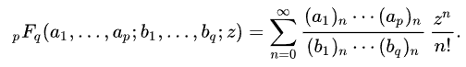

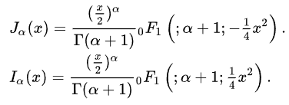
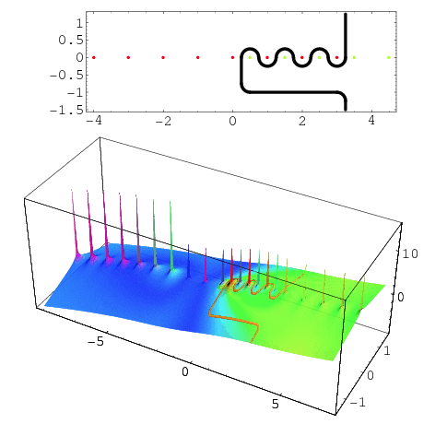
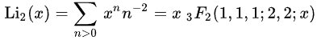

Generalised Hypergeometric Series
The hypergeometric series can be generalised to have $p+q$ coefficients:

Slide 8
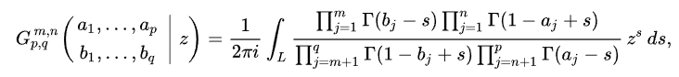
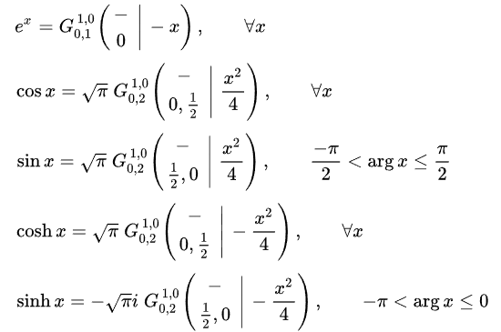
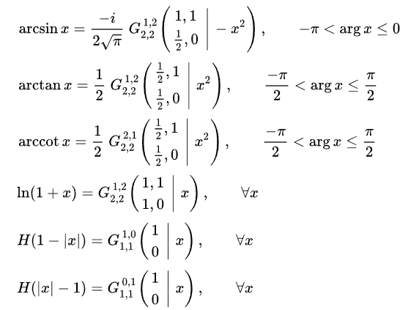
Meijer-G Function
Meijer-G function further generalises:

Slide 9
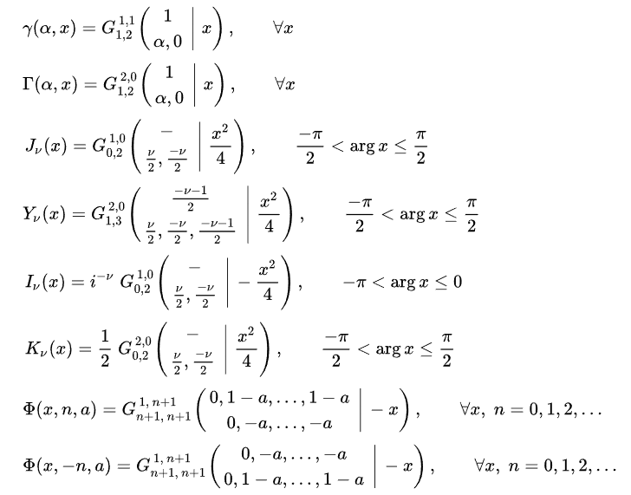
Very powerful functions are special cases.
There are also all the unnamed intermediate functions!

Slide 10

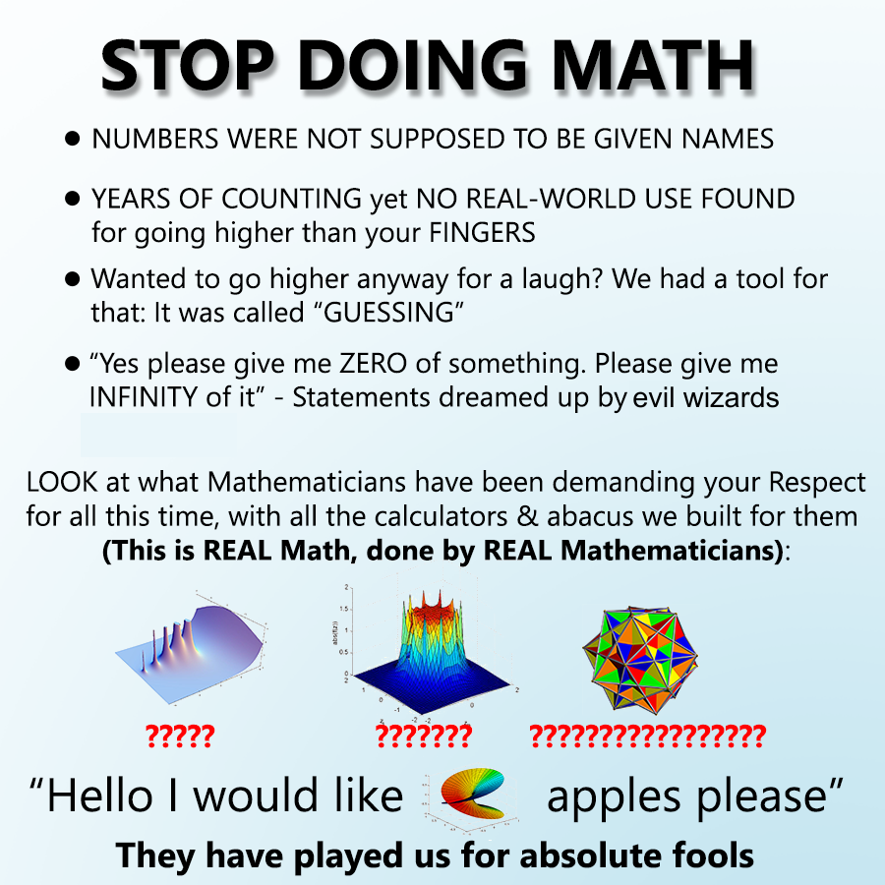
Fox-H function : It keeps going…
By adding only tens of parameters in this way we rapidly expand the space of all functions representable.
We have a fully analytic form…

Slide 11
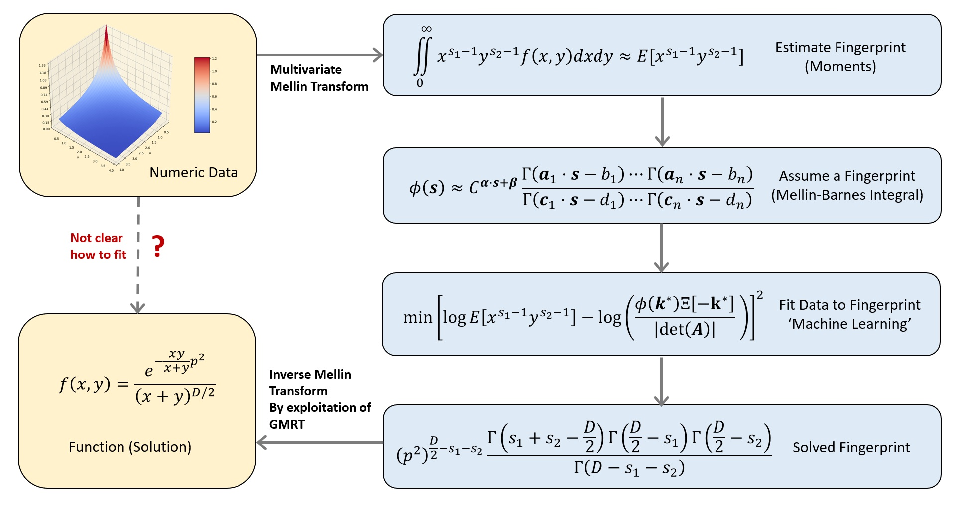
Exact Learning : How does it work?

Slide 12
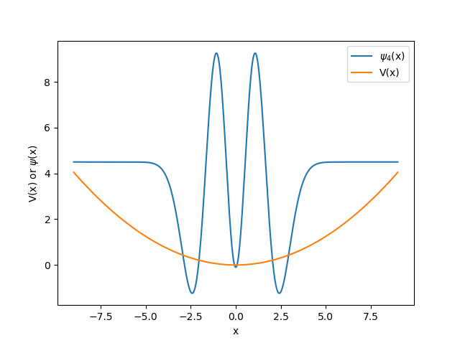
Example: Harmonic Oscillator, 4th Excited State
Numerically Solve
Numerically Interpolate
Numerically Integrate
Apply Exact Learning

Slide 13
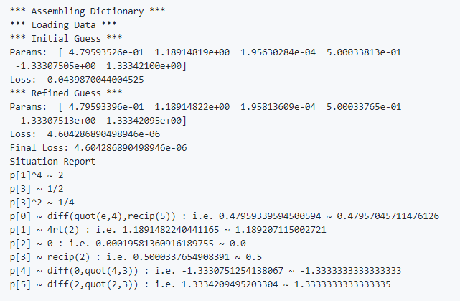

Example: Harmonic Oscillator
$$φ\left(s\right)=A{\sqrt{2}}^{s}\left(1−\frac{4s}{3}+\frac{4s^{2}}{3}\right)Γ\left(\frac{s}{2}\right)$$
$$\sum_{k=0}^{∞}{\frac{{\left(−1\right)}^{k}}{k!}\frac{φ(−s)}{Γ(−s)}x^{k}=Ae^{−\frac{x^{2}}{2}}H_{4}(x)}$$

Slide 14
Applications
Is this a good representation of DFT wavefunctions?
Will this make good quantum descriptors?
Other chemistry problems
Other statistical problems
Early days

